Slide 1
Proteomics Protein separation (IEF-SDS) Protein identification (MS)
Notes:
After two days of working with genes I will tell you something about proteins and the techniques that are used to analyse them.

Slide 2
Proteomics techniques
Protein function
Biochemical assays
Protein micro-arrays
Post-translational modifications
MS or MS/MS
Protein separation
2D gels
Liquid chromatography
Protein identification
MS or MS/MS
Protein micro-arrays
3D structure determination
X-ray
NMR
Homology modelling
Protein-protein interactions
Yeast two-hybrid
Affinity chromatography + MS
In silico techniques
Protein micro-arrays
Notes:
Besides doing biochemcial assays, determining the 3D structure of a protein, further insight into the function of a protein can be obtained by finding out to which proteins each protein can bind.

Slide 3
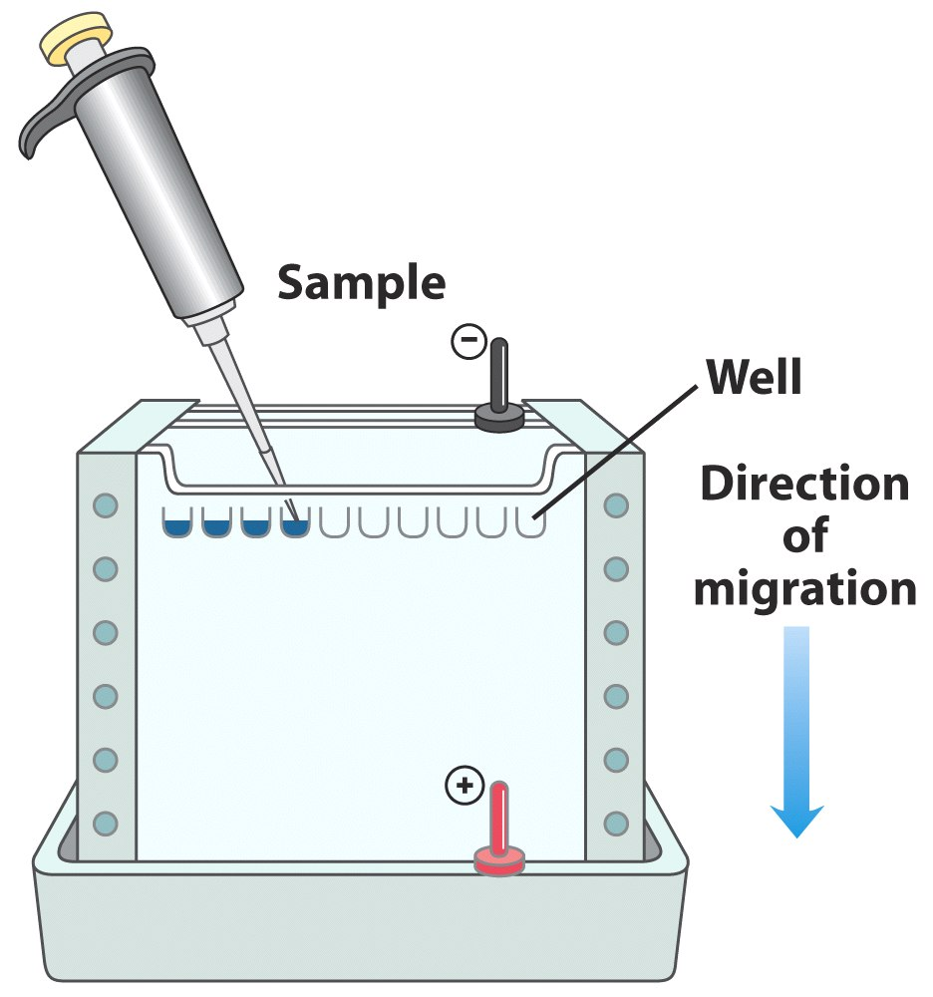
1D
SDS-PAGE
Lehninger, 5th ed. Fig 3-18

Slide 4
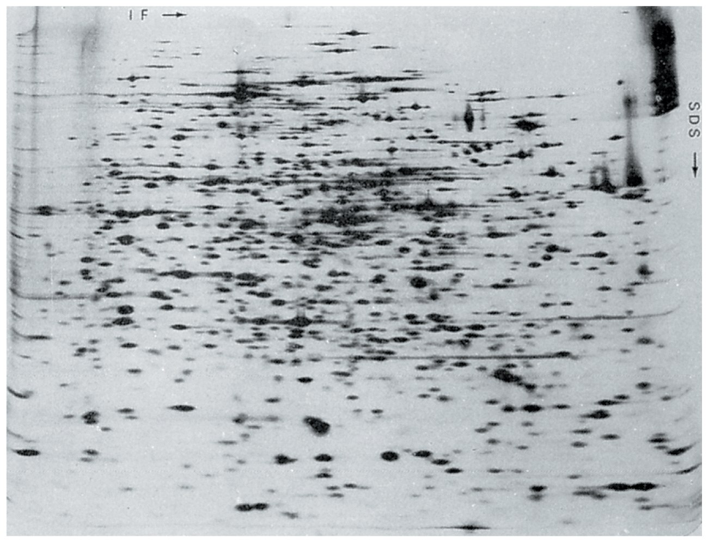
2D: IEF + SDS-PAGE
http://www.expasy.ch/ch2d/

Slide 5
Separation using chromatography
Volatile compounds by GC
Small molecules by LC
Proteins/peptides by LC

Slide 6
Proteomics techniques
Protein function
Biochemical assays
Protein micro-arrays
Post-translational modifications
MS or MS/MS
Protein separation
2D gels
Liquid chromatography
Protein identification
MS or MS/MS
Protein micro-arrays
3D structure determination
X-ray
NMR
Homology modelling
Protein-protein interactions
Yeast two-hybrid
Affinity chromatography + MS
In silico techniques
Protein micro-arrays
Notes:
Besides doing biochemcial assays, determining the 3D structure of a protein, further insight into the function of a protein can be obtained by finding out to which proteins each protein can bind.

Slide 7
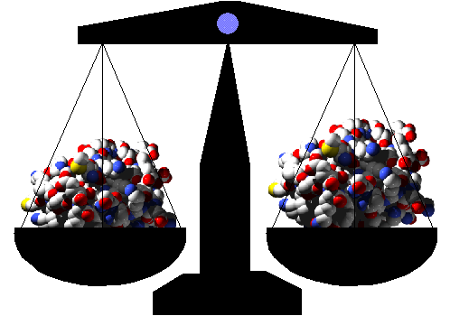
Mass Spectrometry
Analytical method to measure the molecular weight of molecules
Eiwit gevisualiseerd mbv yasara.com
http://rwbforever.tripod.com/laws.htm
Notes:
Mass spectrometry is …, nothing more, nothing less. A mass spectrometer can separate proteins or fragments based on its mass and its charge. If you know the charge, you know the weight.

Slide 8
Outline of an MS experiment
Separation prior to MS
Mass Spectrometry:
Ionization
Mass separation
Detection
Bio-informatics: Identification

Slide 9
Proteomics work flow MS
Sample
2D SDS-Page
Liquid chromatography
Separation
Excise a spot from gel
Collect fractions
Trypsin digestion
Ionisation
Ionisation (+vacuum)
Acceleration
Mass separation
Separation
Detection
Detection
Identification
Identification
Notes:
Proteins can be excised from the gel and identified using mass spectrometry.
Mass spectrometry is one of the techniques that is used very often for proteomics research. Because of its importance we will give a separate lecture about mass spectrometry. For now just remember that you can use MS to identify proteins from a 2D gel, but also from a column using liquid chromatography.

Slide 10
Mass spectrometry
3 fundamental parts:
the ionisation source: molecules are charged
the analyser: separation of the charged molecules
the detector
In the ionisation source, ions (charged molecules) are being formed (positive or negative).
Separation in analyser according to mass-to-charge ratios (m/z).
Detection of separated ions and their relative abundance.
Signals sent to data system and formatted in a spectrum.

Slide 11
Peptide Mass Mapping or Mass Fingerprint identification
Identify a protein based on very accurate measurements of the mass/charge (m/z) ratios of its peptides
1. Fragment protein into peptides
2. Place charge(s) on the peptides + vacuum
3. Acceleration in a magnetic field
4. Separate fragments + detection
5. Compute m/z ratio and identify protein
Notes:
With peptide mass fingerprinting you want to identify a protein based on …
There are 5 steps..

Slide 12
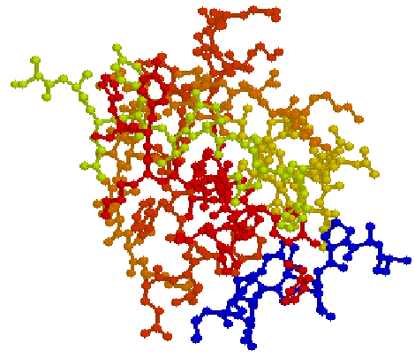
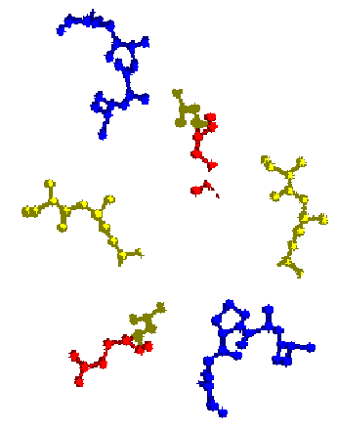
Step 1: Fragment a protein into peptides
Enzyme
Protein
Peptides
Enzyme:
Trypsin used most often (95%)
Trypsin cleaves protein behind R (arginine) or K (lysine)
Aebersold & Mann, Nature vol 422, 198-207 (2003)
Notes:
First step:

Slide 13

Peptide Mass Mapping
Identify a protein based on very accurate measurements of the mass/charge (m/z) ratios of its peptides
1. Fragment protein into peptides
2. Place charge(s) on the peptides + vacuum
3. Acceleration in a magnetic field
4. Separate fragments + detection
5. Compute m/z ratio and identify protein
Proteins need to fly !
http://www.pinterest.com/pin/416723771740235459/
Notes:
How to cleave the protein into peptides is obvious, but how to do step 2-4. If you want to measure the acceleration of molecules in a magnetic field they need to fly.

Slide 14
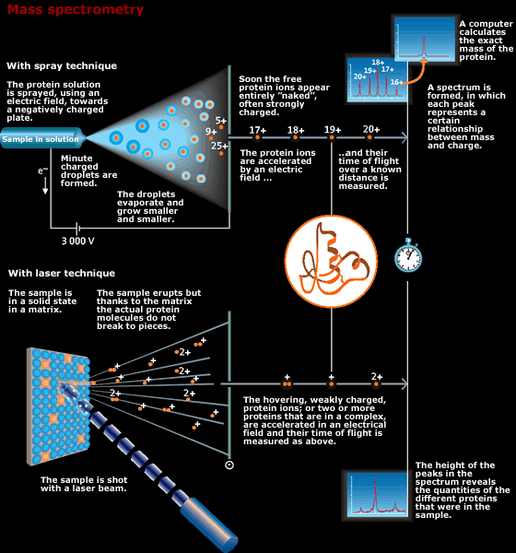
Nobel committee 2002 for John Fenn
Notes:
Let op ladingen

Slide 15
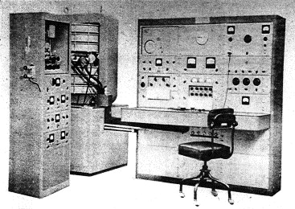
Journal of the American Society for Mass Spectrometry Volume 13, Issue 11, November 2002, Pages 1254–1272
The Consolidated Electrodynamics Corp. Model 21-103C massspectrometer.
Left: Inlet system cabinet (in the author’s laboratory, the top portion was enclosed and heatable to 250 °C);
Center: 3-Coil electromagnet, the flight tube in the middle, main pumping system housed below;
Right: Operator console (note the round door in the upper left for retrieval of the photographic recording paper).
Mass spectrometers in the 1960’s
Notes:
The Consolidated Electrodynamics Corp. Model 21-103C massspectrometer. Left: Inlet system cabinet (in the author’s laboratory, the top portion was enclosed and heatable to 250 °C); center: 3-Coil electromagnet, the flight tube in the middle, main pumping system housed below; right: Operator console (note the round door in the upper left for retrieval of the photographic recording paper).
Journal of the American Society for Mass Spectrometry Volume 13, Issue 11, November 2002, Pages 1254–1272

Slide 16
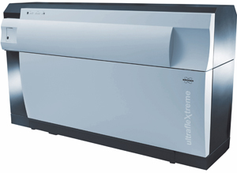
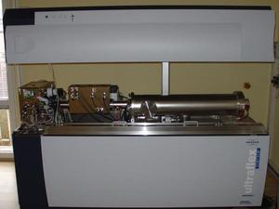
Modern MS instrument
http://www.dddmag.com/products/2009/06/maldi-tof-mass-spectrometer
Notes:
Here is a modern instrument, which is much better and smaller than the one you saw before. This is a MALDI mass spec. The vacuum pumps are hidden away, so you don’t see them anymore.

Slide 17
Soft Ionisation Methods
337 nm UV laser
Fluid (no salt)
+
_
cyano-hydroxy
cinnamic acid
Gold tip needle
MALDI
Matrix Assisted Laser Desorption Ionisation
ESI
Electrospray Ionisation
Notes:
ESI and MALDI are “soft” ionisation methods that allow the formation of ions without the protein of peptides breaking into smaller pieces again. This is important because it enables accurate mass information to be obtained about proteins and peptides in their native states. MALDI is a very easy method to use and is used most often for peptide mass mapping. ESI is much more delicate. ESI is most often used for peptide sequencing. Therefore I will today focus on MALDI.

Slide 18
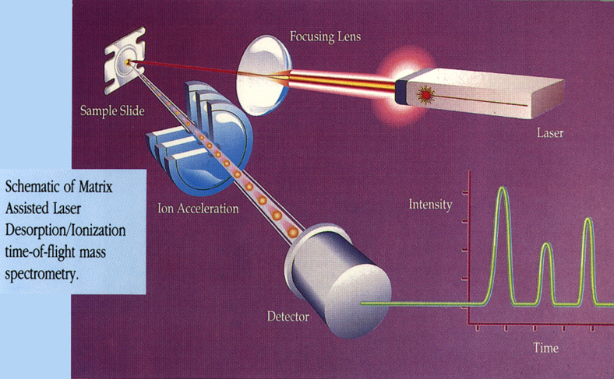
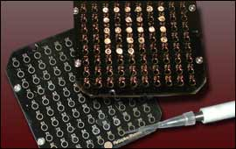
The Principles of MALDI
Dissolve compound and add matrix, then add sample to sample plate
Evacuate air from sample chamber
Laser shoots pulses of light at sample
http://www.protein.iastate.edu/maldi.html
Notes:
Here the principle of MALDI is explained.
You first cleave your protein into pieces. The peptides are then mixed with matrix molecules and this mixture is then added to the sample plate. Modern sample plate ~ 400 wells. 9x9 cm. The sample plate is put into the machine and the air is pumped out of the sample chamber. Then a laser shoots at the sample on the sample plate and as a result the peptides are transformed into ions which are sucked into the ion accelerator after which they can be measured by a detector. When the ions hit the detector a signal is generated resulting in a spectrum.

Slide 19
Matrix-Assisted Laser Desorption Ionisation
337 nm UV laser
Sample is mixed with a UV absorbent matrix
sinapinic acid - proteins
4-hydroxy-cinnaminic acid - peptides
Sample is ionised by bombarding sample with laser light
Light wavelength matches the absorbance maximum of matrix
>>> matrix transfers some of its energy to the analyte (leads to ion sputtering)
cyano-hydroxy
cinnamic acid
MALDI
Notes:
After you have the sample plate in the machine you shoot at the sample with laser light. The technique is called MALDI where the D stands for Desorption. Your sample is mixed with a UV absorbin compoundg, because you need some matrix molecules to assist in the laser desorption. This absorbing compound is not always the same. There are different kinds of matrix molecules depending on the types of molecules you would like to observe. For proteins you can use sinapic acid, for peptides you use cinnamic acid. This is based on practical evidence. How this works in theory is not known. Of course the light absorbance of the matrix molecules should fit with the laser in order transfer the energy of the laser to the matrix molecules. If this is the case it will result in a small explosion.

Slide 20
MALDI Ionisation
+
Matrix
+
Absorption of UV radiation by matrix molecules and ionisation of matrix
Dissociation of matrix
Phase change to super-compressed gas
Charge transfer to analyte molecule
Expansion of matrix at supersonic velocity, analyte trapped in expanding matrix plume (explosion/”popping”)
+
-
-
Laser
-
+
Analyte
+
+
+
-
+
+
-
+
-
-
+
+
+
+
+
+
Notes:
When you hit the matrix molecules with the laser, then the energy is absorbed and as a result there is a small explosion. The explosion actually is an expansion of the matrix molecules at supersonic speed. At the time of the explosion there a chemical process is going on. The chemistry combined with the energy of the laser creates charged proteins and peptides. Due to the explosion that happens, the molecules will leave the solid state and will enter the gas phase. The molecules are then charged. When there is an electric field above the MALDI-plate they will be accelerated in the direction of the electric field. They will then enter the time of flight tube.

Slide 21
MALDI
MALDI generates spectra that have just a singly charged ion
(ESI generates multiply charged ions)
Positive mode generates ions of M + H
Negative mode generates ions of M - H
Robust (tolerates salts and nonvolatile components in sample)
(ESI does not tolerate salts)
Easy to use and maintain, capable of high throughput
(ESI is expensive and difficult to handle, but much more sensitive)
Requires 10 μL of 1 pmol/μL sample
Notes:
MALDI usually generates sinly charged ions. You will get either 1+ or 1- as a charge on a peptide or protein. When you add a proton to charge the peptide it is called positive model, when you extract a proton it is called negative mode.
Maldi is a very robust technique. It is more robust than electrospray ionsation, because with MALDI you can have salts or other components in your sample and it will still work. MALDI is much easier to use than electrospray ionisation mass spec. Electrospray is a very difficult technique, the instrument is expensive and delicate, so you need a lot of experience. MALDI is easy to use, everyone of you can analyse samples on a MALDI. And with MALDI you can do high throughput experiments. How much protein do you need for a MALDI analysis. You need only about 10 pmol of protein, which you can add to the sample plate in about 10 microliter. So the amount of protein needed is quite low.

Slide 22
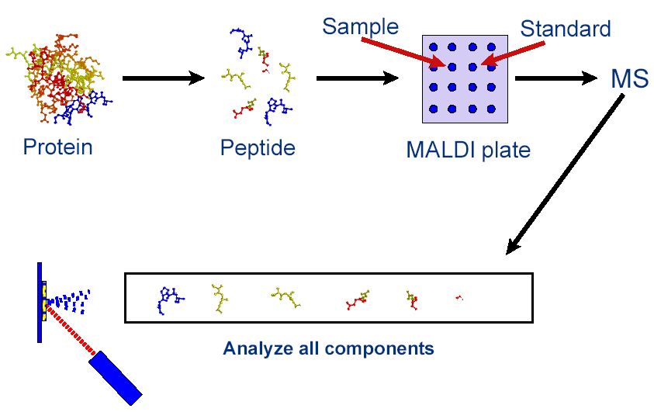
Step 2-4: Peptide Mass Mapping using MALDI-TOF
Aebersold & Mann, Nature vol 422, 198-207 (2003)

Slide 23
Maldi movie !!
MALDI-TOF.mpg
Notes:
Here you see the laser. The laser hits the sample plate and all molecules in the well, which you hit are vapourised and now they entering the TOF tube. The time it takes to hit the detector is a few nanoseconds. The ones that are quite heavy arrive later than the ones that are quite light. In principle, with MALDI, you have only one positive or negative charge, so you can determine the mass directly from the time. The sample plate is about the size of my hand. The number of wells on the sample plate is presently in the order of 400 wells. So you can have 400 samples on one maldi sample plate. You shoot at a specific position with a laser, the molecules are vapourized and then the enter the time of flight tube. In reality you do not measure as quickly as shown here in the animation. The size of the well is much larger than the spot hit by the laser. So you can hit the same well two times, 10 times or even 50 or 100 times. You can add up these spectra and thus increase the signal to noise ratio. So depending on what signal to noise ratio you want to have you shoot the well multiple times. When you do an experiment you have to calibrate the TOF tube, because it can change it length a little bit due to temperature changes. You can switch on a reflector in the TOF tube to extend the length of the tube. The molecules are then reflected to a second detector. The time of flight will then take longer and the longer the time of flight the better the separation of the molecules.

Slide 24
Example of a MALDI-MS spectrum
20000
pHBH trypsin digest
500 a.a
15000
10000
Intensity
5000
0
500
1000
1500
2000
2500
mass (m/z)
http://mascot.proteomix.org/help/
Notes:
Here we have a typical mass spectrum from a protein. The protein of about 500 amina aicds is digested by the protease trypsin. This results in a large amount of peptides. Each of these peptides gives a peak in the mass spectrum.

Slide 25
TOF Analysis
Charge = z
Accelerating voltage = V
Mass = m
Velocity = v
Distance = d
TOF = t
zV = ½ mv²
V = ½ mv²/z
2V= mv²/z
but v = d/t
m/z = [2V/d²]t²
t = (m/z)^{1/2}(d²/V)^{1/2} Time is directly related to mass/charge !
When the mass is larger it takes longer to arrive to the detector.
A large charge decreases time.
Notes:
If you do some calculations you will see that time is important. The time it takes to hit the detector is related to the mass divided by the charge. The distance from the beginning to the end of the TOF tube is in principle always the same for each experiment. And the same is true for the voltage applied to the electric field. So both voltage and distance are set.
If you have two positive charges or two negative charges instead of only one, then it takes half the time it reach the detector, because it flies faster in the electric field.
The mass is the mass that you are interested in and the charge is one or two in MALDI, but usually one. So then you measure the time. So the time is directly related to the mass divided by the charge.

Slide 26
Example of a MALDI-MS spectrum
20000
pHBH trypsin digest
500 a.a.
15000
10000
Intensity
5000
0
500
1000
1500
2000
2500
mass (m/z)
http://mascot.proteomix.org/help/
Notes:
As a result of MALDI MS you can obtain a spectrum like this. This is the spectrum we saw before. In this spectrum you can see that not all peaks have the same height. Some peaks are very high, which means that there was a lot of that peptide present in the sample. Some peaks are low, which means that there was not so much of that peptide present in the sample.
the larger the molecule, the more difficult to ionise, the lower the intensity of the peak
In principle if the Mass Spec has high resolution you can measure proteins up to 200.000 – 300.000 Dalton. IgG is a protein of 140.000 Dalton can easily be oberserved. But even a molecule of about 100.000 Dalton can most times be easily observed using Mass Spec. But the larger the protein the more difficult it is to observe the protein, because the peak is not so intense. So it is more difficult to observe large molecules. If you want to observe large molecules you need more protein than when you want to analyse small molecules/peptides. Compared to the 2D-gels this technique is thus much, much more sensitive and accurate. With MS, when you have a good instrument, it is even possible to discriminate whether the proteins of 50-60.000 Dalton contain a phosphate group, which is 80 Dalton.

Slide 27
Resolution & Resolving Power
Width of peak indicates the resolution of the MS instrument
The better the resolution or resolving power, the better the instrument and the better the mass accuracy
Resolving power is defined as: M / ΔM
M is the mass number of the observed mass.
ΔM is the difference between two masses that can be separated
Notes:
There are a few things about MS that are important and that you should remember. What is important in mass spectrometry is to have a good resolution. The better the resolution, the narrower the peaks will be. When peaks are narrow you can more easily see the difference between two peaks. The difference between the various mass spectrometers is often related to the resolution. The higher the resolution, the more expensive the instrument will be. Now be careful resolution is not always defined the same.

Slide 28
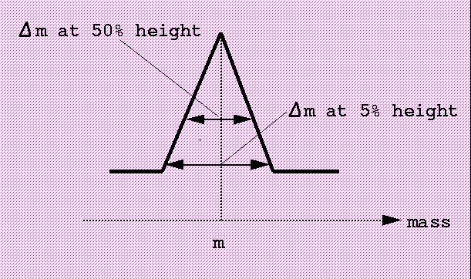
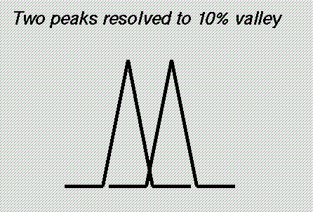
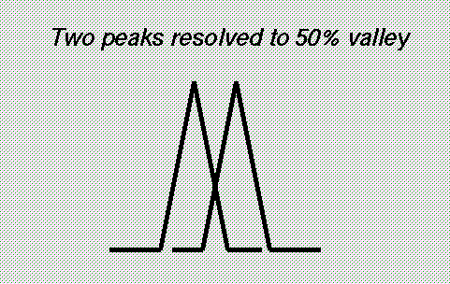
Resolution in MS
Resolving power is defined as: M / ΔM
M is the mass number of the observed mass.
ΔM is the difference between two masses that can be separated
TOF instruments: 50% valley
FTMS: 10% valley
http://mascot.proteomix.org/help/mass_accuracy_help.html
Notes:
Resolution can be defined at a 50% valley of at a 10% valley. So what does this mean. The valley is the space between two peaks. With a 10% valley, the peaks overlap at 10% from their maximum. With a 50% valley the peaks overlap at 50% of their maximum. Now resolution is defined as the difference between two masses that can still be separated divided by the mass of the observed mass.
For example, you have a TOF instrument, when looking at the 50% valley, it can still separate 2 peaks one of 200.0 Dalton and the other of 200.1 Dalton. The resolution will then be 0.1 divided by 200 = 0.0005
Now resolution for other instruments can be defined at a 10% valley. When you look at different instrument qualifications, you should be careful how resolution is defined some define it at the 50% valley and others at the 10% valley. Of course at the 50% level you will obtain a higher level of resolution number than when you define it at the 10% level. So what does resolution imply.

Slide 29
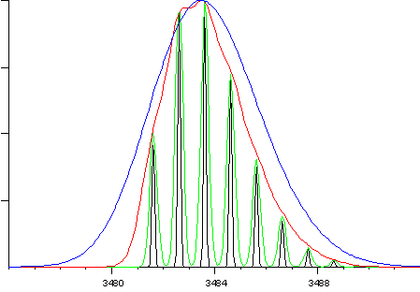
Mass spectrum of the molecular ion of Glucagon
at different resolutions
The figure shows the molecular ion of glucagon
at resolutions of 1000 (blue), 3000 (red), 10,000 (green) and 30,000 (black).
http://mascot.proteomix.org/help/mass_accuracy_help.html
Notes:
Here is a nice example. When you have a molecule, glucagon, and you have a bad resolution, here in blue, then you cannot observe the different peaks in the molecule. Why you have all these different peaks I will tell you in a minute. When you have a very good resolution, here in black, you can observe all the different peaks of the glucagon molecule easily. So depending on the quality of your instrument, you either observe 8 peaks or you observe 1. It is clear that when you observe 8 peaks there is much more information available to you than when you would have only one peak. So the TOF instruments that were available upto 10 years ago often had resolutions like the red or the bleu. This was quite OK for organic chemistry application, but when you wanted to have a higher resolution you needed a magnetic sector instrument, but these were very expensive and they were difficult to handle.
With the invention of electrospray ionisation in the middle of the nineties, it was also possible to analyse proteins and do proteomics. That was when the booming business started for the companies that made mass spec instruments. With the help of researchers they started to develop instruments that could reach a much higher resolution. So at the moment we have instruments that have resolutions like the black or the green.
3000 = ion trap, 10.000 = TOF, 30.000-500.000 = FT-MS.

Slide 30
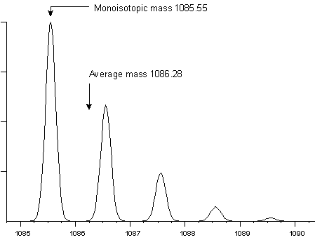
The peptide HLKTEAEMK
Average molecular weight = 1086.28
Monoisotopic weight = 1085.55
Resolution = 5000
http://mascot.proteomix.org/help/mass_accuracy_help.html
Notes:
So this is what we now can easily obtain. Here is a peptide, a peptide with nine amino acids. When you look at the mass spectrum you observe more than one peak. Why do we observe more than one peak?
This is because in nature there exist isotopes. What is the most abundant isotope in nature among biological molecules or said in another way: which atom has the highest percentage of different isotopes in biological molecules. Carbon. Carbon-12 is almost 99 percent Carbon-13 is 1.1 percent. You can do a statistical calculation for our peptide of 9 amino acids. This peptide contains a certain amount of carbons, so in your sample there will be molecules present that contain one or more carbon-13 atoms. Besides carbon-13 there is also Nitrogen-15. 99.6 percent of the nitrogen atoms will be Nitrogen-14. Almost 0.4 percent of the nitrogen atoms will be Nitrogen-15. So this should also be taken into account. There are also other isotopes, but to this we will come back a little later.
So we have a isotopic distribution. The first peak in the mass spectrum is called the mono-isotopic peak, because it only contains carbon-12 and nitrogen-14. The next peak is one Dalton larger, because it contains either a carbon-13 or a nitrogen-15 atom. The third peaks is two Daltons larger than the first peak, because it contains two carbon-13 or nitrogen-15 atoms, and so on.
When you don’t have a good resolution, you will not obtain these peaks but you will get only 1 broad peak. The only thing you can then do is to determine the average mass. The average mass is less accurate then the mono-isotopic mass and I will show you why. So let’s get up in molecular mass.

Slide 31
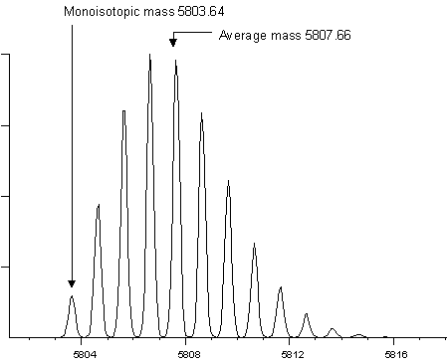
Insulin
http://mascot.proteomix.org/help/mass_accuracy_help.html
Notes:
Here we have insulin. Insulin is a protein peptide of about 50 amino acids. Of course when you have more atoms there is a higher chance of having higher isotopes and you will have a larger isotopic distribution. You can see that the peak on the left is now smaller in intensity than the other peaks, because the chance that the molecule did not contain any higher isotopes is small. Still if you can observe this mono-isotopic peak it is very useful, because this mass you can measure with very high precision if you have a good instrument. If you are able to very precisely measure the mono-isotopic mass it is much more easy to identify your protein based on the peptide composition. We will come back to this in the exercises.

Slide 32
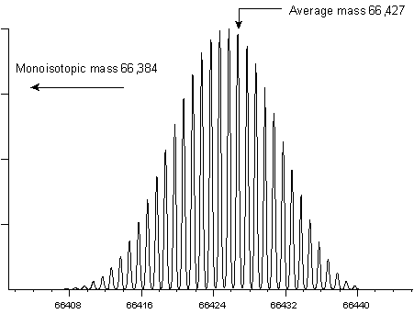
Bovine Serum Albumine (BSA)
http://mascot.proteomix.org/help/mass_accuracy_help.html
Notes:
Here is bovine serum albumin. It is about 600 amino acids. The mono-isotopic mass you will not see in the mass spectrum, because BSA contains so many cabons and nitrogens. So the chance that a molecule contains only carbon-12 and nitrogen-15 is almost zero. So you cannot see the mono-isotopic mass, what you can see if you have a good instrument like this one is a isotopic distribution from which you can calculate the average mass. Of course the average mass is never as accurate as the mono-isotopic mass.
I will come back to proteins, but first a short intermezzo.

Slide 33
Questions:
Is the isotopic distribution of biological molecules (proteins, DNA, lipids, ligands, sugars etc.) always the same ?
Is, for a certain molecule produced by a certain species, the isotopic distribution for that molecule always the same?
Notes:
First question: is the isotopic ratio of biological molecules always the same?
The second question is a little bit more strict. So take a certain organism, for example an oak tree and isolate a certain protein from that organism, for example a kinase. Is the isotopic distribution for this protein always the same.

Slide 34
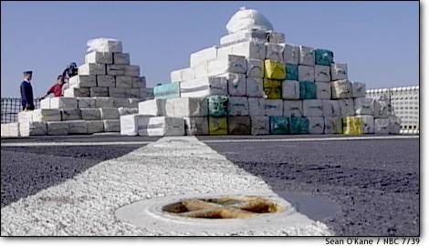
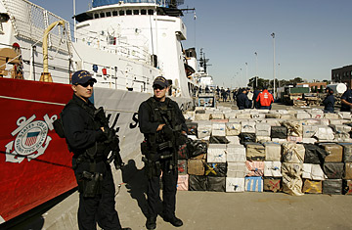
Where does this
cocaine come from?
http://www.kpic.com/news/national/7168961.html
Notes:
In 2007 the US Coast Guard fished 40.000 kg of cocaine out of the Pacific.

Slide 35
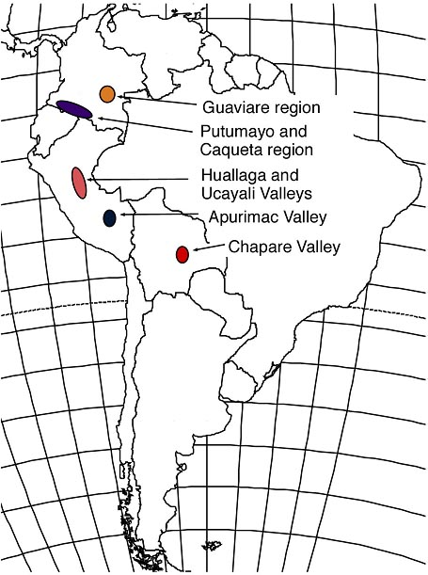
Cocaine producing regions in South America
Almost all of the cocaine in South America originates from 5 regions
These regions fall along a climatic gradient with the wettest regions in the north and driest in the south
http://ecophys.biology.utah.edu/
Notes:
In South America there are 5 places where they produce cocaine. Because south america is quite large, in each of these regions there is a different climate.

Slide 36
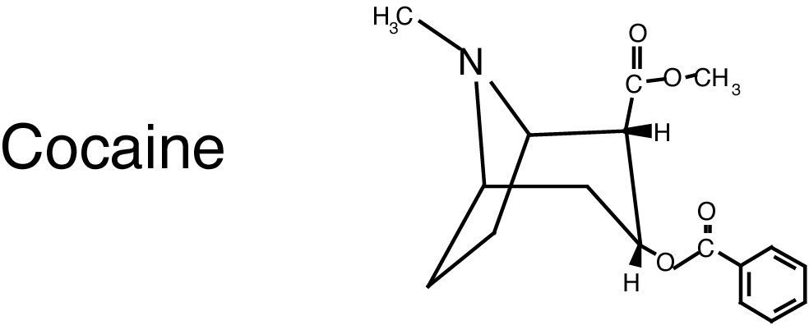
from soil
c
from photosynthesis
or humidity
from water source
and humidity
http://ecophys.biology.utah.edu/
Notes:
Here is cocaine. Now what turns out is that depending on the location in South America the cocaine molecule has a different isotopic distribution. For example you look at the Nitrogen molecule. The plant takes this molecule from the soil. Because of the climate changes the nitrogen isotopes present in nature have a slightly different ratio when comparing one region with another region.
This is also the case in the Netherlands. When you go from Germany to the North Sea, the closer you will get to the North Sea the more Deuterium (heavy hydrogen) there is present in the water. Deuterium was not included in the cocaine analysis, but it could be included.

Slide 37
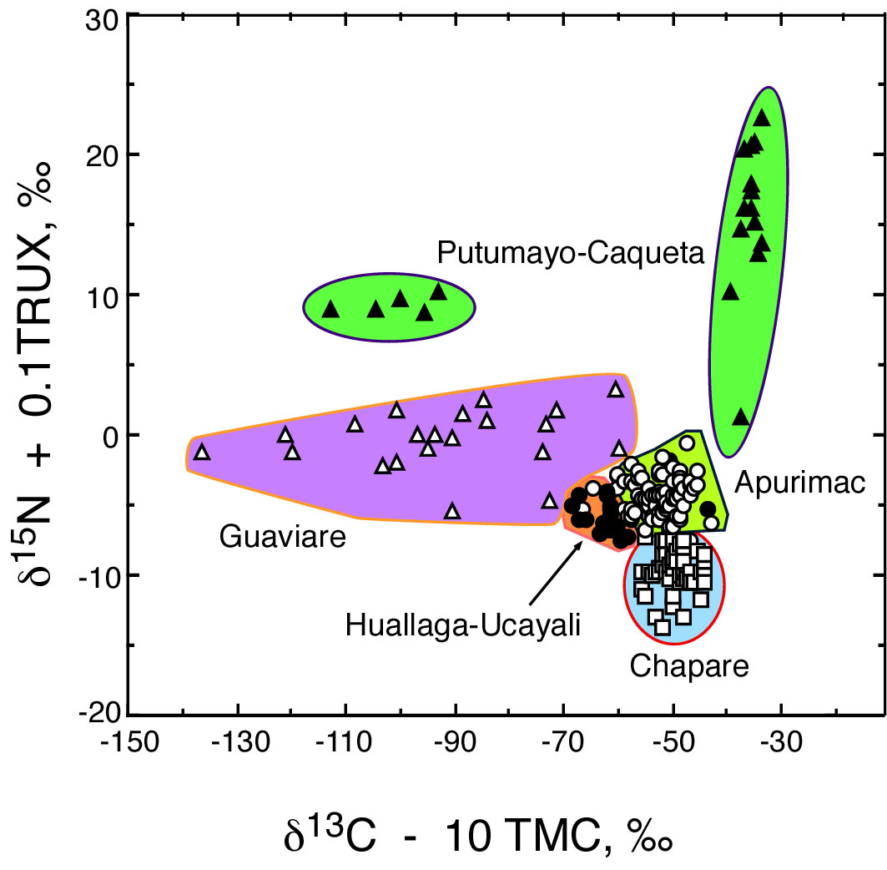
Where does the cocaine come from?
Cocaine
~96 % of the variation explained by
C¹³ and N¹⁵ distribution
Nature 2000
408: 311-312
Notes:
When you very precisely measure the weight of the cocaine molecule and analyse in detail the different isotopes in the cocaine molecule you can determine from its isotopic distribution from which region in south america the cocaine is coming from. You can see that in Putumayo-Caqueta, a region in columbia, there are even two cocaine producing regions.
So the isotopic distribution is not the same for a certain molecule from a particular organism. It depends on the where it was growing. It is not really proteomics, but these kind of analyses will come more and more in future to help us to answer our biological questions or for forensic research.

Slide 38
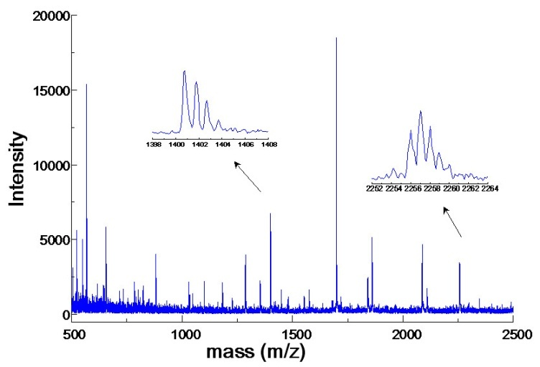
Peptide Mass Mapping
?
MS
protein
peptides
http://mascot.proteomix.org/help/
What are the masses of the peptides?
time = mass / charge
Aebersold & Mann, Nature vol 422, 198-207 (2003)
Notes:
Now back to proteins.
We saw that for peptide mass mapping you first cleave your protein into peptides. The masses of these peptides are then measured by MS and these masses you can use to identify the protein that was being analysed. But MS measured the Mass over charge ratio. What are now the masses of the peptides

Slide 39
Example of a MALDI-MS spectrum
20000
pHBH trypsin digest
15000
1398
1400
1402
1404
1406
1408
10000
Intensity
2252
2254
2256
2258
2260
2262
2264
5000
0
500
1000
1500
2000
2500
mass (m/z)
http://mascot.proteomix.org/help/
Notes:
When you have a good instrumentation that gives you a good resultion you can for each peptide see the isotopic distribution. For smaller peptides, you see the mono-isotopic mass as the largest peak. At the right is a larger peptide. There the mono-isotopic mass peak is not the largest peak.
Keep this in mind, because I am going to show you some formulas

Slide 40
Use isotope distribution to determine charge
1 H ≈ 1 Da
m/1 = m
m/2 = 0.5 m
m/4 = 0.25 m
1 Da
z = 1
http://mascot.proteomix.org/help/mass_accuracy_help.html
Notes:
Remember that if you have a good resolution, you can see the isotopic distribution of each peptide. If you have C13 instead of C12, there is one extra Hydrogen. Hydrogen is roughly 1 Da, so the distance between the two peaks will be 1 Da. But this is only true if the charge of the peptide is 1. If the charge of the peptide is 2 or 4. The mass of the peptide will be divided by 2 or 4. As a result the distance between the isotopic peaks will also get smaller, because 1 dived by 2 is 0.5 and 1 divided by 4 is 0.25. So if you peptide has a charge of 4, the distance between the isotopic peaks will be 0.25 instead of 1. If your mass spec has a good resolution you can immediately see what the charge of your peptide was and very easily determine its mass.

Slide 41
Step 5: Peptide Mass Mapping
?
MS
protein
peptides
http://mascot.proteomix.org/help/
Peptide masses
Compare with peptide masses in selected databases
NDALYFPT...
SWDLTAL...
PTDLDVSY...
Identify protein
Tool “Peptide mass”: http://web.expasy.org/peptide_mass/
Aebersold & Mann, Nature vol 422, 198-207 (2003)
Notes:
So we started with cleaving our protein into peptides. Then did MS analysis on these peptides. We obtained a spectrum and based on the isotopic distribution we could determine the masses of the peptides. In order to identify the protein we can compare these masses with peptide masses in selected databases.

Slide 42
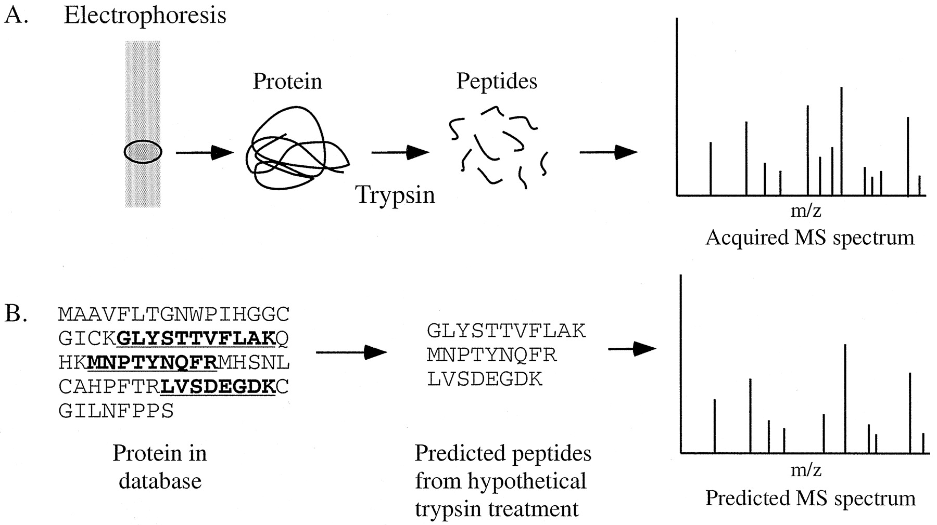
Peptide Mass Mapping
Graves P R , Haystead T A J Microbiol. Mol. Biol. Rev. 2002;66:39-63
http://mmbr.asm.org/content/66/1/39/F9.expansion.html
Notes:
The peptide masses with which we compare our masses are obtained by in silico cleavage proteins in the database with trypin.

Slide 43
Peptide Mass Mapping
?
MS
protein
peptides
http://mascot.proteomix.org/help/
Peptide masses
Rank possibilities
multiple peaks
mass accuracy
confirming information (pI, approx. mass, organism, etc.)
Identify protein
Compare with peptide masses in selected databases
NDALYFPT...
SWDLTAL...
PTDLDVSY...
Aebersold & Mann, Nature vol 422, 198-207 (2003)
Notes:
If you have a large database, which is nowadays almost always the case. There probably will be more than one possible candidate for our protein. In order to determine which is the protein we were actually analysing you can rank the possibilities. Ranking takes place based on the amount of peptides that could be mapped on the protein. If there are still many possibilities that all map several peptides, it is possible to reduce the search space. In other words, make the database smaller. This you can do by adding information about the protein into your search. For example, from which organism is it coming. What is its approximate mass.
Now it is time to try these things for your self.

Slide 44
Protein identification
Protein 2
576.3635
755.4654
756.4494
797.5011
810.4348
832.4555
833.4396
925.5961
941.5658
1036.6645
1037.6485
1767.8428
1194.6469
1253.6041
1254.5881
1907.1092
1908.0932
1381.6990
1383.7722
1384.7562
2777.3313
2778.3153
2138.0644
1455.7722
1456.7562
1554.6733
778.4337
795.4603
2404.2962
1626.8465
2517.4530
2556.2231
1754.9414
1779.0142
1785.8111
3694.8955
3266.6935
3940.8863
4077.8601
Protein 1
784.4344
756.4283
1062.5458
1118.5397
2445.2288
1431.7722
1614.8981
1615.8821
3277.7387
2670.2086
2676.4123
2539.3210
572.2819
756.4283
1118.5397
2445.2288
1431.7722
3277.7387
2670.2086
2676.4123
2539.3210
Identification of 2 proteins found to interact with a receptor kinase from Arabidopsis thaliana.
Plant kinases can phosphorylate on Serine and Threonine !!! = variable modification
The components of the complex were digested by trypsin. Trypsin missed some cleavages (set missed cleavages at 2).
The obtained fragments were very precisely analysed by Maldi-TOF MS (peptide mass tolerance 100 ppm).
http://www.matrixscience.com/search_form_select.html

Slide 45
sample
MS¹
Fragmentation with trypsin + soft Ionization
ions
Selection/isolation
1 isolated ion
MS²
Fragmentation by adding energy
fragments
Selection/isolation
(MS³)
1 isolated fragment
Fragmentation by adding energy
fragments

Slide 46
Fragmentation (in-source; MS/MS of MS^{n})
In-source fragmentation occurs due to high energy ionization
MS/MS or MS^{n} are controlled fragmentation processes.
Fragments give information about the structure of a molecule

Slide 47
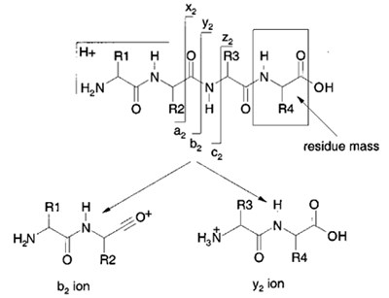
Fragmentation of a peptide (MS-MS)
Aebersold and Goodlett 2001 Mass spectrometry in proteomics. Chemical Reviews 101(2): 269-295.

Slide 48
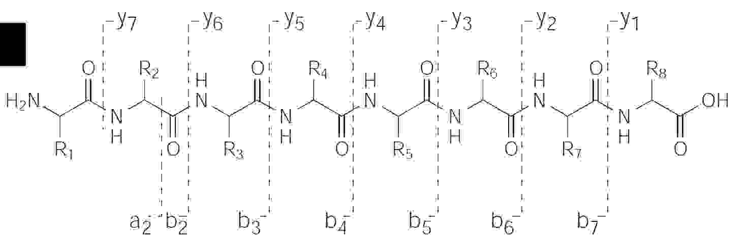
Peptide fragmentation – b and y ions
THE ABC’S (AND XYZ’S) OF PEPTIDE SEQUENCING. H. Steen and M. Mann. Nature Reviews 2004 Vol 5 blz 699-711

Slide 49
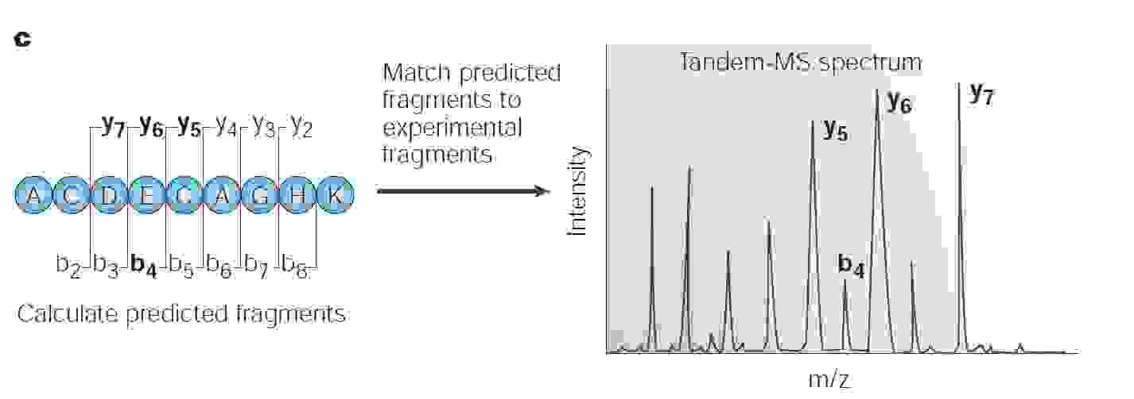
Mascot peptide identification
THE ABC’S (AND XYZ’S) OF PEPTIDE SEQUENCING. H. Steen and M. Mann. Nature Reviews 2004 Vol 5 blz 699-711

Slide 50
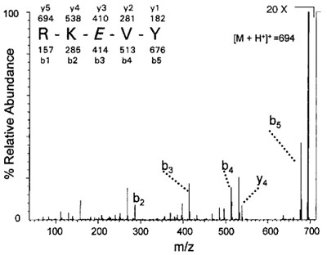
Aebersold and Goodlett 2001 Mass spectrometry in proteomics. Chemical Reviews 101(2): 269-295.

Slide 51
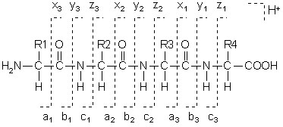
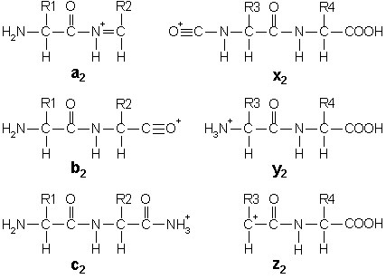
Nomenclature peptide fragmentation. Picture from Matrix Science, http://www.matrixscience.com/help_index.html.

Slide 52
Peptide identification
BEGIN IONS
TITLE=978
PEPMASS=729.385649
CHARGE=2+
333.172302 4608.0
498.201141 3300.0
562.260925 5523.0
633.286011 11430.0
797.492188 1522.0
825.424072 6906.0
960.487427 11650.0
1031.522705 5931.0
1259.594604 3449.0
1311.656128 3310.0
399.234436 2540.0
448.164124 2384.0
596.477417 1800.0
613.076477 4595.0
780.639526 1307.0
896.503784 4799.0
922.430176 4744.0
1010.510864 2318.0
314.076416 1545.0
569.255249 1600.0
698.115234 2853.0
845.327515 4419.0
1023.486816 1408.0
300.042114 1330.0
595.433533 1458.0
635.103882 2555.0
863.646606 3977.0
627.317932 2363.0
806.784912 3713.0
694.462402 1860.0
835.344482 2810.0
605.509949 1749.0
807.557007 1715.0
699.28186 1693.0
604.600586 1625.0
650.408203 1572.0
655.374878 1547.0
673.657837 1184.0
674.406067 1323.0
690.603638 1363.0
END IONS
Identification of 2 peptides from Arabidopsis expressed as response to a stress reaction
Static modification: Carbamidomethyl (C)
Variable modification: Deamidation (NQ)
Set missed Trypsin cleavages at 2
Precursor mass tolerance: 7 ppm
Fragment mass tolerance: 0.8 Da
http://www.matrixscience.com/search_form_select.html

Slide 53
Bronnen
Afbeeldingen van internet geraadpleegd op 18-11-2012
Wetenschappelijke literatuur:
Journal of the American Society for Mass Spectrometry Volume 13, Issue 11: 1254–1272 2002
Aebersold & Mann, Nature vol 422: 198-207, 2003
Graves P R , Haystead T A J Microbiol. Mol. Biol. Rev. 66:39-63, 2002
Nature 408: 311-312, 2000
Aebersold and Goodlett, Mass spectrometry in proteomics. Chemical Reviews 101(2): 269-295, 2001.
Steen H. and Mann M., THE ABC’S (AND XYZ’S) OF PEPTIDE SEQUENCING. Nature Reviews Vol 5 blz 699-711 2004
Copyright @ I. Paffen, HAN

